Slide 1
College 101
SNAP E&T program

Slide 2
Agenda
Student ID
Class/Program Schedule
Technology Overview
Essentials for Your Career Overview
Transportation
Habits for Success
Being a Gateway Student
Health & Safety Info

Slide 3
TAKE NOTES

Slide 4
SNAP E&T Program
Monthly verification​
Monthly registration​
Communication is key: ​
email: tgaudioso@gatewayct.edu
phone: 203-285-2299
Flexibility and adaptability……..and patience
Own your education

Slide 5
Field Trip!
…...to the ID Center

Slide 6
Student IDs
Access to parking (Gateway and Temple garages)
Entrance to building
Banner ID: for logging onto computers and accessing student email account

Slide 7
Reading Your Schedule
M T W R F S
Class delivery methods:
TRAD=traditional - held on campus
LRON=live remote - held remotely – you will be expected to log onto the class via your home device at the day/time your class meets
ONL=online - on Blackboard - complete work at your own pace
*HYBR=hybrid - some of the class is held on campus, and some is held remotely*
specific days/times for in-person vs remote are different depending on the class; and will depend on the state of the pandemic*
‘N’ vs ‘S’ sides of the building
Dates/times

Slide 8
Program Schedules

Slide 9
Bookkeeping
Introduction to Microsoft | TRAD | TR | 06:00 pm-09:30 pm | 08/25-09/01
Microsoft Word - Daytime | LRON | TR | 09:30 am-01:00 pm | 09/03-09/29
Microsoft Word - Evening | LRON | TR | 06:00 pm-09:30 pm | 09/03-09/29
Business Math | LRON | MW | 06:00 pm-10:00 pm | 09/14-09/28
Principles of Accounting | LRON | MW | 06:00 pm-09:30 pm | 09/30-11/02
Microsoft Excel - Daytime | LRON | TR | 09:30 am-01:00 pm | 10/01-10/27
Micosoft Excel - Evening | LRON | TR | 06:00 pm-09:30 pm | 10/01-10/27
Intro to Benefits Admin. | HYBR | S | 09:00 am-01:00 pm | 10/17-11/21
QuickBooks | LRON | MW | 06:00 pm-09:00 pm | 11/11-12/16

Slide 10
Business Professional & Office Assistant
Introduction to Microsoft | TRAD | TR | 06:00 pm-09:30 pm | 08/25-09/01
Microsoft Word - Daytime | LRON | TR | 09:30 am-01:00 pm | 09/03-09/29
Microsoft Word - Evening | LRON | TR | 06:00 pm-09:30 pm | 09/03-09/29
Six Sigma White Belt Cert | LRON | MW | 06:00 pm-09:30 pm | 09/02-09/16
Conflict Resolution | TRAD | MW | 06:00 pm-09:00 pm | 09/21-10/05
Microsoft Excel - Daytime | LRON | TR | 09:30 am-01:00 pm | 10/01-10/27
Micosoft Excel - Evening | LRON | TR | 06:00 pm-09:30 pm | 10/01-10/27
Office Procedures&Project Mgt | LRON | MW | 06:00 pm-09:30 pm | 10/26-11/09
ABC's of Written Communication | LRON | MW | 06:00 pm-09:30 pm | 10/07-10/21

Slide 11
Business Professional & Office Assistant (cont)
Microsoft Access | LRON | TR | 06:00 pm-09:30 pm | 10/29-11/24
Office Communication | LRON | MW | 06:00 pm-09:30 pm | 11/11-11/30
Microsoft PowerPoint | LRON | TR | 06:00 pm-09:30 pm | 12/01-12/15
Taking Minutes | LRON | MW | 06:00 pm-09:30 pm | 12/02-12/09
Presentation Skills | LRON | MW | 06:00 pm-09:30 pm | 12/14-12/30
Microsoft Outlook | LRON | TR | 06:00 pm-10:00 pm | 12/17-12/22
MS Project | TBD | TBD | TBD | TBD
Bus Sys App | TBD | TBD | TBD | TBD

Slide 12
CNA
Certified Nurse's Aide | HYBR | MTWRF | 09:00 am-02:30 pm | 08/21-09/25

Slide 13
Community Health Worker (CHW)
Community Health Worker | HYBR | MW | 06:00 pm-09:00 pm | 08/31-03/31
 | HYBR | S | 09:00 am-12:00 pm | 08/31-03/31

Slide 14
Desktop Support/A+ CompTIA
Virtual model
10-12 weeks
2 nights/week
Exam at end (in person)

Slide 15
Digital Media & Web Design
Introduction to the MAC | TRAD | TR | 06:00 pm-09:00 pm | 09/08-09/15
Adobe Photoshop | LRON | TR | 06:00 pm-10:00 pm | 09/17-10/20
Adobe Illustrator | LRON | TR | 06:00 pm-10:00 pm | 10/22-11/10
Freelance & Job Essentials | LRON | MW | 06:00 pm-10:00 pm | 11/16-11/18
Adobe InDesign | LRON | TR | 06:00 pm-10:00 pm | 11/17-12/10
How to Create a Web Page | LRON | MW | 06:00 pm-09:00 pm | 12/09-12/18
Build Website Using Wordpress | LRON | TR | 06:00 pm-10:00 pm | 12/15-12/29
Design Essentials | TBD | TBD | TBD | TBD
Digital Printing | TBD | TBD | TBD | TBD

Slide 16
Medical Office Assistant
Introduction to Microsoft | TRAD | TR | 06:00 pm-09:30 pm | 08/25-09/01
Medical Terminology | HYBR | MW | 06:00 pm-09:00 pm | 08/31-10/05
Microsoft Word - Daytime | LRON | TR | 09:30 am-01:00 pm | 09/03-09/29
Microsoft Word - Evening | LRON | TR | 06:00 pm-09:30 pm | 09/03-09/29
Microsoft Excel - Daytime | LRON | TR | 09:30 am-01:00 pm | 10/01-10/27
Micosoft Excel - Evening | LRON | TR | 06:00 pm-09:30 pm | 10/01-10/27
Medical Coding ICD9 &10 | HYBR | MW | 06:00 pm-10:00 pm | 10/07-11/09
UB04 Form | LRON | S | 09:00 am-12:00 pm | 11/07-11/21
Medicare/Medicaid Reimburse | HYBR | MW | 06:00 pm-10:00 pm | 11/11-11/30
Commercial Insurance | HYBR | MW | 06:00 pm-10:00 pm | 12/02-12/16
CMAA Exam Prep | LRON | MW | 06:00 pm-10:00 pm | 12/21-01/06

Slide 17
Pharmacy Technician
Pharmacy Technician Program | HYBR | TR | 06:00 pm-09:00 pm | 09/08-12/17

Slide 18
Security Guard
Conflict Resolution | TRAD | MW | 06:00 pm-09:00 pm | 09/21-10/05
Protective Srvcs Career Pathwy | TRAD | T | 06:00 pm-09:00 pm | 10/06-12/08
Security Guard Card Cert | TRAD | R | 08:00 am-04:00 pm | 10/7
Time Mgmt & Report Writing | TRAD | MW | 06:00 pm-09:00 pm | 11/02-11/11

Slide 19
ServSafe
Food Handler - ServSafe | LRON | TR | 09:30 am-01:30 pm | 10/06-10/08
Food Safety Mgt - ServSafe | LRON | TR | 09:30 am-01:30 pm | 10/13-11/05

Slide 20
Technology
Gateway student account - logging on
Blackboard
Microsoft Teams
Outlook (email) - USE STUDENT EMAIL ONLY
WebEx
Before leaving, try to login to a Gateway computer w/ student account

Slide 21
IT Services
IT Office is open (in person): Mon-Fri 8am to 4:30pm
All on-site services will be done by telephone or appointment. In order to maintain proper social distancing, walk-in services are not available.
To contact Gateway Help Desk:
203-285-2040 (during open hours they should pick up; after hours=calls monitored until 7pm) - leave name, description of issue and callback #
gw-helpdesk@gwcc.commnet.edu

Slide 22
College Environment
ID: parking, entrance into building, printing……..$10 to replace card
Banner ID: this is your student ID #; use to log onto student account (in person or remotely) - do not share this with others
Parking: Gateway or Temple Garage
Library, Labs, Cafeteria, etc

Slide 23
Supplies for Success
Device at home (laptop, desktop, tablet) - see us if you do not have this
Reliable internet
Flash drive w/ resume and cover letter OR easy access to these docs
Pocket folders
Notebooks
Highlighter
Writing utensils
Daily planner
Index cards

Slide 24
Holidays, Closures & Inclement Weather
College does not follow holidays of public school system
Planned days off are in fall catalog (in process of updating)
Inclement weather=check local news sources

Slide 25
UPASS
Application process: https://www.gatewayct.edu/Appointment-Booking
Bus is free in CT until further notice

Slide 26
Succeeding in College
“Consistency of effort over the long run is everything”

Slide 27
Biggest Predictor of Success
Grit
Having stamina for long periods of time without giving up on your goals
How do we develop grit? By adopting a Growth Mindset

Slide 28

Growth Mindset

Slide 29
Student Success Packet
Time Management
Choices of Successful College Students
Learning Styles
Taking Notes
Study Habits

Slide 30
Behaviors to Avoid in the Classroom
Tardiness
Leaving class early
Cheating/plagiarism
Dominating discussion
Speaking out of turn
Disengaging
Offensive remarks
Verbal/physical threats

Slide 31
Class Time
If you’re going to be late=contact instructor ASAP
Unless it’s an emergency, you’re expected to stay the entire class - leaving early will negatively impact your grade
2 unexcused absences=withdrawn from program
Set an alarm to remind you it’s time to GO!

Slide 32
Student Conduct
Student Handbook: https://gatewayct.edu/Current-Students

Slide 33
Proper use of College Resources
All resources and facilities on the System Data Center, including the computer center and campus computing sites, are to be used solely for legitimate and authorized academic and administrative purposes

Slide 34
Safety Systems
Wear a mask at all times (not allowed in building without one)
Follow signage on campus for social distancing (elevator capacity, standing spots, cones, etc)
Practice good hygiene
Empower yourself - exercise, eat well, get enough sleep, get outside - proactive approach to safety

Slide 35
Essentials for Your Career
Designed to help students increase their employability skills
Resume
Cover letter
Job search/application process
Interview

Slide 36
Essentials for Your Career (cont)
Starts tonight (Aug 4) for some
Schedule was emailed; have it printed here - if you’re not sure what your schedule is, see me at the end
Should show up on your Blackboard - if not, contact us
If you are NOT enrolled, contact Kandace or I if you would like to request job seeking-related support

Slide 37
Other stuff
Who needs Intro to Microsoft? Take poll.
All set w/ technology at home?
Book, Bus Prof, MOA stu’s=am or pm Word & Excel?

Slide 38
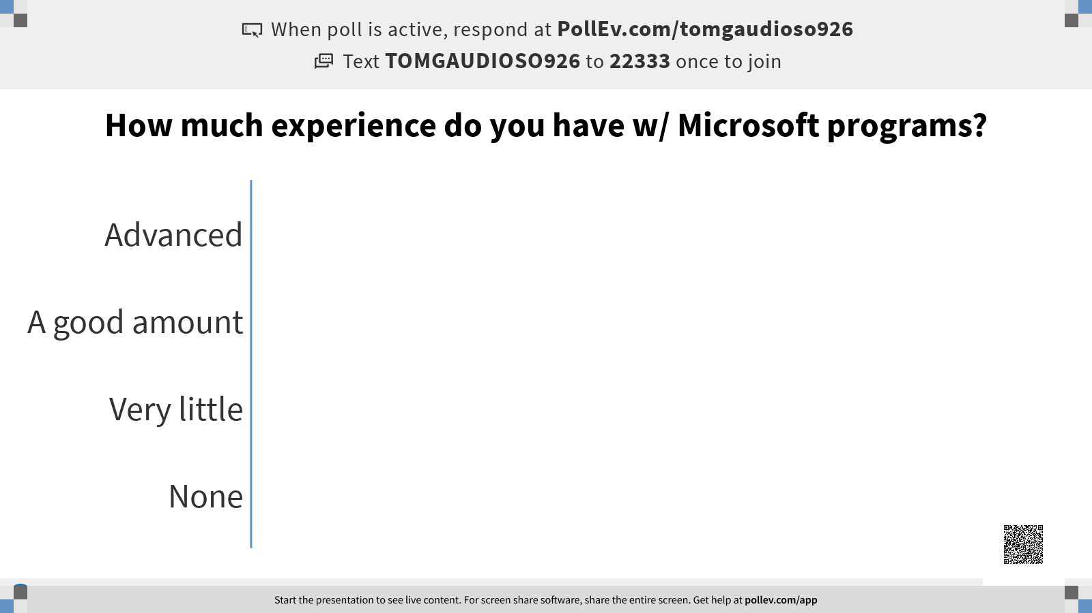

Slide 39
FLEXIBILITY, ADAPTABILITY, PERSISTENCE
YOU GOT THIS!

